Slide 1
Pennine Connect Analysis
Turning operational data into actionable churn insights
Hitesh Sahoo
2nd July, 2026

Slide 2
Business Problem
Current challenge :-
Data exists across multiple operational systems
No unified customer lifecycle view
Difficult to identify early warning signals
Customer churn is reactive
Goal: Build a reliable churn analytics layer to identify at-risk customers earlier

Slide 3
Part A — Model the data
Build a clean monthly subscription fact suitable for churn reporting:
1. One row per active subscription per month, with its MRR.
2. Resolve any data-quality problems you find, and briefly document what you did and why.
3. Flag each subscription’s lifecycle state (active, voluntary cancellation, cancelled-before-go-live, fraud, reactivation).

Slide 4
Part A.2 : Data Quality Checks
1. Customers Data(TB_CUSTOMERS)
No Data quality issues detected.
Observations:
Significant decline observed from Jan'23 → Feb'23 (21 → 12).
Sharp seasonal drop during Oct'23 → Nov'23 (15 → 6).
Strong recovery in Nov'23 → Dec'23 (6 → 16).
Peak performance observed in Feb'24 → Mar'24 (13 → 26).
Consistent post-March decline across years (Mar'24 → Apr'24: 26 → 19, Mar'25 → Apr'25: 20 → 13), suggesting a recurring seasonal trend.
Nov'25 → Dec'25 showed a decline (20 → 14), unlike the previous years, indicating a potential area for investigation.
Implementation:
CDC to track changes of customers for SCD2 implementation.
Added Column “customer_tenure_days” i.e. since how long customer is part.

Slide 5
Part A.2 : Data Quality Checks
2. Subscriptions Data(TB_SUBSCRIPTIONS)
Data issue detected
Observations:
32 rows are duplicated | Need to dedup else MRR will spike.
10 Active customers having go live date as future, so they are yet to go live, so no need to calculate MRR that will spike
For Subscription 100067 with Customer 57 status is doa but Cancelled Date is in future i.e. 2026-07-20.
Implementation:
Deduplicated in staging model using row_number() = 1
Added flag column is_pending_activation_flag where go_live_date > current_date.
Logically inconsistent for “doa” but held for Business input before correction rather than silently auto-fix.

Slide 6
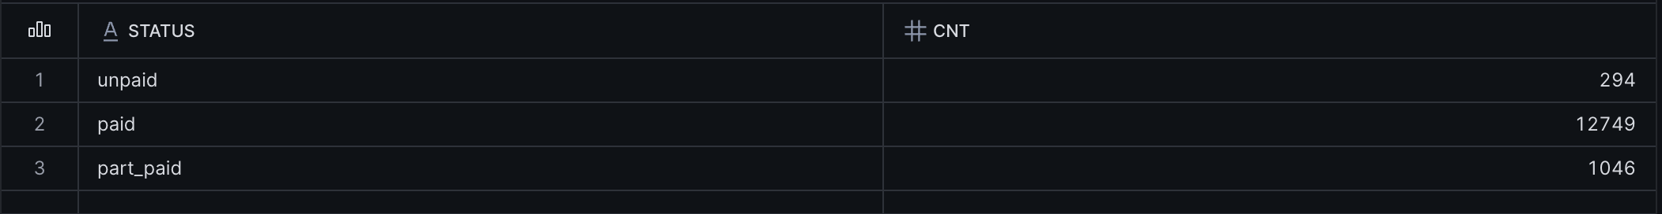
Part A.2 : Data Quality Checks
3. Billings Data(TB_BILLINGS)
No Data quality issues detected.
Observations:
Validated data completeness and integrity by checking for duplicate records, null keys, valid date ranges, and non-negative billing amounts.
Verified business rule consistency, ensuring payment status aligned with amounts (e.g., paid = full payment, unpaid = zero payment, part-paid = partial payment).
No data quality issues identified; the billing dataset was found to be consistent and ready for downstream analytics and churn reporting.
Implementation:
Created 1-1 mapping staging table.
**signal detected : 1**Status paid/unpaid/part_paid might be one of the signal for churn.

Slide 7
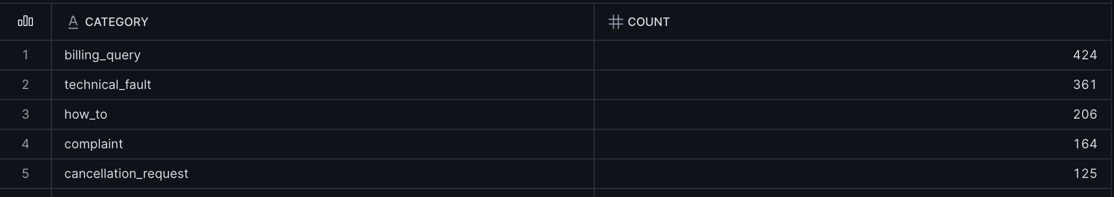
Part A.2 : Data Quality Checks
4. Support Contacts Data(TB_SUPPORT_CONTACTS)
No Data quality issues detected.
Observations:
Data quality is strong with no duplicate records, null primary/foreign keys, or invalid date values.
181 unresolved tickets (resolved_at is NULL), which appears to be expected for open support cases.
All resolved tickets have a valid lifecycle (created_at < resolved_at), indicating consistent timestamp integrity.
Implementation:
Introduced derive column is_unresolved_flag to explicitly identify open vs. closed support tickets.
Created resolution_hours column(resolved_at - created_at) to measure support performance and enable SLA reporting.
**signal detected : 2 and 3** There are 2 category i.e. complaint and technical_fault could be potential signal for churn.

Slide 8
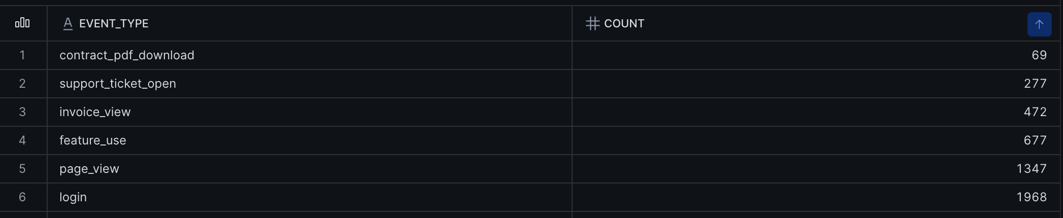
Part A.2 : Data Quality Checks
5. Portal Events Data(TB_PORTAL_EVENTS)
Data quality issues detected.
Observations:
Event data is structurally sound, with no duplicate event IDs, null event IDs, or invalid event timestamps.
34% of records (1,640 / 4,810) have a NULL customer_id, indicating incomplete customer linkage (potential late-arriving or orphaned events).
All Customer_ID is in decimal format e.g. 501.0 | Required cleaning
**signal detected : 4** Portal activity includes 277 “support_ticket_open” event_type, which could serve as a potential leading indicator for customer dissatisfaction and churn.
Implementation:
Created is_customer_linked_flag to identify events with missing customer_id until source data is backfilled. Business input required rather than removing the rows silently.
Standardize customer_id by converting decimal values to the integer format during the dbt staging layer.
Further investigate whether support_ticket_open events correlate with increased churn risk and incorporate them into the churn prediction model if validated.

Slide 9
Part A.2 : Data Quality Checks
6. Usage Daily Data(TB_USAGE_DAILY)
No Data quality issues detected.
Observations:
Usage daily data passed all quality checks with no duplicate records, null subscription IDs, invalid dates, or negative/null usage metrics.
The (subscription_id, usage_date) combination is unique, making it a reliable business key for daily usage analysis.
**signal detected : 5** Daily usage metrics (call_count, call_minutes, concurrent_peak) are potential candidate for behavioural trend analysis.
Implementation:
Created 1-1 mapping staging table.
**signal detected : 6** Investigate the business meaning of concurrent_peak and evaluate whether it can serve as a leading indicator of customer engagement or churn risk.
Derive additional behavioural features (e.g., average daily calls, monthly call minutes, usage trend) for churn analytics and dashboarding.

Slide 10
Part A.3 - subscription’s lifecycle state
The problem:
Raw status (active/cancelled/doa/fraud) doesn't tell the full story — a cancelled subscription could be a genuine loss, or a customer who came back later.
Solution : Created intermediate table INT_SUBSCRIPTION_LIFECYCLE to map status using below rules.
Order | Status | Rule
1 2 | Fraud | status = fraud — always excluded from churn, it's a risk event not a retention one
2 | Cancelled-before-go-live | status = doa — never went live, no revenue lost
3 | Pending activation | active status but go-live date is still in the future
4 | Reactivation | Same customer + same product, came back after a prior cancellation
5 | Voluntary cancellation / Active | Status = Cancel / Active
Key design decisions:
Partitioned by customer + product, not customer alone — a customer switching from broadband to mobile isn't "reactivation," it's cross-sell.
Precedence is deliberate — fraud and DOA are checked first because they override every other state; a fraudulent signup can't also be counted as a “win-back."
Built using LAG() window functions to compare each subscription against that customer's previous subscription of the same product — validated against real cases in the data (e.g. customer 501) before trusting the logic.
LAG of status and cancelled_date to know previous status and cancelled_date, to know reactivation.

Slide 11
Part A.1 - One row per active subscription per month, with its MRR.
Implementation:
Created fact table fct_subscription_monthly with below logic.
Key design decisions:
Filtered relevant lifecycle states
Included only Active, Voluntary Cancellation, and Reactivation subscriptions with valid go-live dates.
Calculated subscription duration
Derived start and end months using go-live, cancellation, or current date logic.
Expanded to monthly reporting grain
Generated a month spine and exploded each subscription into one row per active subscription per month with MRR.
Key Attributes:
Subscription ID
Customer ID
Activity Month
Product
Plan
Lifecycle State
MRR
Lifecycle Intermediate Table
(Filtered States)
│
▼
Calculate
Start & End Month
│
▼
Generate
Month Spine
│
▼
Expand Subscription
Across Months
│
▼
FCT_SUBSCRIPTION_MONTHLY
(1 Row = 1 Subscription × 1 Month)

Slide 12
Part B — Define Metric and Find a Signal
1. Churn Rate
2. Leading Indicator
3. Recommendation

Slide 13
Part B.1 : Churn Rate
Implementation: Created fct_churn_metrics with below steps
Step 1 – Define the Reporting Window
Generated a rolling 12-month reporting period to analyse monthly churn trends.
Excluded the current partial month to ensure complete and comparable metrics.
Step 2 – Establish the Active Customer Base
Counted subscriptions active at the start of each month as the churn denominator.
Excluded subscriptions not yet live or already cancelled to avoid overstating the active base.
Step 3 – Identify Genuine Churn Events
Counted only Voluntary Cancellations as churn events.
Excluded Fraud and Cancelled Before Go-Live; tracked Early-Life Churn separately while retaining it in the churn metric.
Step 4 – Calculate Monthly & Annualised Churn
Calculated Monthly Churn Rate = Churned Subscriptions ÷ Active Base.
Annualised using the compounded formula to reflect the cumulative impact of monthly churn.

Slide 14
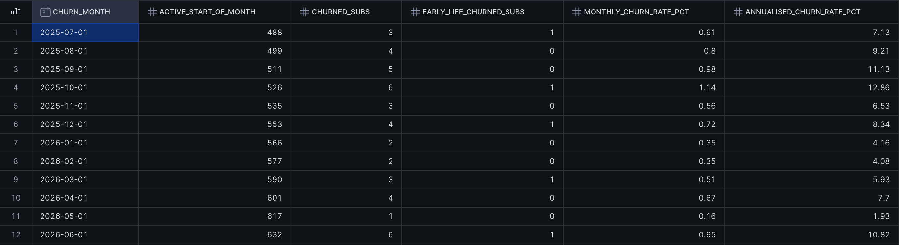
Part B.1 : Churn Rate
Data Table:

Slide 15
Part B.3 : Churn Rate Recommendations
Key Insights:
Monthly churn remained consistently below 1.2%, indicating a relatively stable subscription base over the last 12 months.
Annualised churn ranged from 1.93% to 12.86%, with the highest churn observed in October 2025 and June 2026, suggesting periods that warrant further investigation.
Early-life churn was minimal (0–1 subscription per month), indicating that new customer onboarding is generally effective.
Despite periodic churn, the active subscription base grew by ~30% over the last 12 months (488 → 632), indicating overall customer growth exceeded customer attrition.
Business Recommendation
Investigate the root causes behind the churn spikes in October 2025 and June 2026 using customer behaviour, support interactions, and billing history.
Develop an early warning framework to proactively identify at-risk customers before voluntary cancellation.
Continue monitoring early-life churn as a leading quality metric for customer onboarding and service activation.

Slide 16
Part B.2 : Leading Indicator
Implementation: Created fact table fct_leading_indicator_scan with below steps
Step 1 – Establish a Common Observation Window
Evaluated all candidate signals within a fixed 60-day lookback period before each subscription's reference date.
Ensured every indicator was measured using the same time horizon for a fair comparison.
Step 2 – Test Multiple Churn Hypotheses
Evaluated all *6 signals* behavioural, support, portal activity, billing, and usage-based indicators.
Compared how frequently each signal appeared in churned versus active subscriptions.
Step 3 – Quantify Churn Risk
Calculated a Risk Ratio by comparing the occurrence rate of each signal in churned and active populations.
A Risk Ratio > 1 indicates increased churn risk, while < 1 indicates a protective behaviour.
Step 4 – Select the Strongest Business Signal
Identified the indicator with the highest and most defensible risk ratio.
Used the findings to recommend a proactive customer retention strategy.

Slide 17
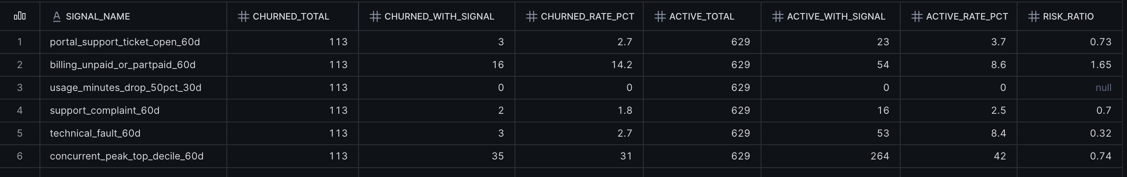
Part B.2 : Leading Indicator
Data Table:

Slide 18
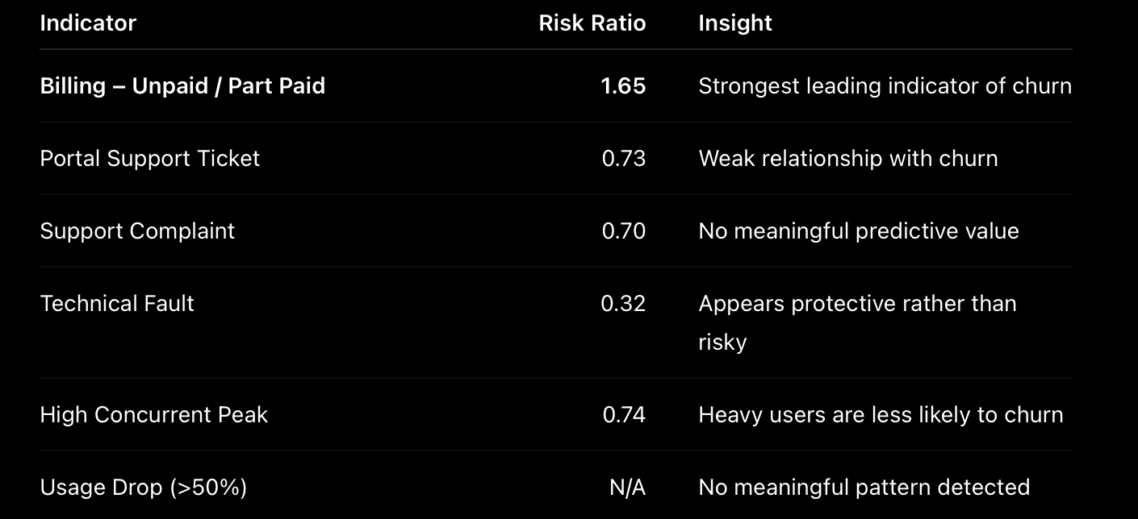
Part B.3 : Leading Indicator Recommendations
Key Insights:
Executive Insights:
Customers with unpaid or partially paid invoices were 1.65× more likely to churn within the following 60 days than customers without payment issues.
Behavioural and support-related signals did not show meaningful predictive power in this dataset.
High product usage appears to be protective, suggesting highly engaged customers are less likely to cancel.

Slide 19
Part B.3 : Leading Indicator Recommendations
Key Insights:
Business Recommendation:
Prioritise customers with unpaid or partially paid invoices for proactive retention campaigns within the next 60 days.
Integrate billing health into a customer risk score to trigger early intervention by Customer Success teams.
Continue monitoring additional behavioural signals as more historical data becomes available to improve predictive accuracy.

Slide 20
Part C — Communicate and Productions
Build a clean monthly subscription fact suitable for churn reporting:
1. Executive Summary(One Page)
2. Dashboard
3. Productionisation

Slide 21
Part C.1 : Executive Summary
**Please refer to attached document in mail

Slide 22
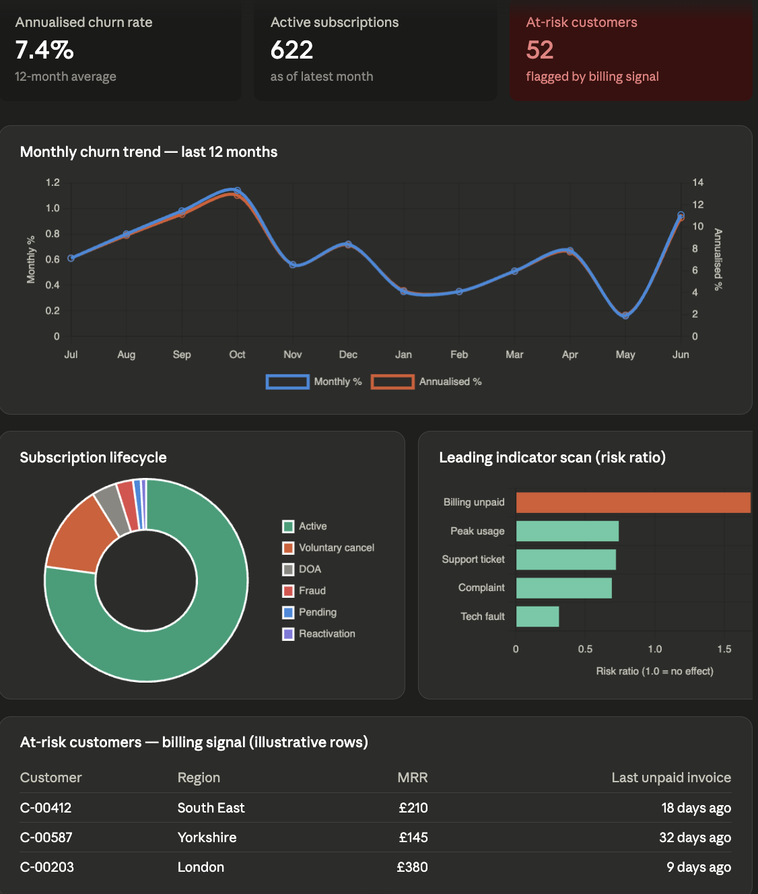
Part C.2 : Dashboard
KPI cards (churn rate, active subs, at-risk count) Snapshot of business health today: 7.4% annualised churn, 622 active subscriptions, 52 customers currently flagged as at-risk.
Monthly churn trend (12 months) Churn fluctuates between ~2% and ~13% annualised with no sustained upward or downward trend — normal variation at our current scale, not a deteriorating business.
Subscription lifecycle breakdown Of 806 total subscriptions, 622 are healthy and active; the remainder splits cleanly into voluntary churn (113), failed activations (32), fraud (22), pending go-lives (10), and win-backs (7)
Leading indicator scan Tested six behavioural signals against actual cancellations — only billing friction (unpaid/part-paid invoices) meaningfully raises risk (1.7x)
At-risk customer table The actionable output: customers currently showing the billing-risk signal, ready for proactive retention outreach before they reach cancellation.

Slide 23
Part C.3 : Productionisation
1. Data quality checks + notification framework
Since Snowflake/bigquery doesn't enforce primary/unique key constraints, duplicate and integrity checks have to happen in the pipeline, not the database engine. dbt is the right tool for this — two tiers:
Structural tests (dbt's built-in unique, not_null, accepted_values, relationships) at RAW and staging — catch the mechanical stuff, like the 32 duplicate subscription_id rows we found.
Business-logic/KPI threshold tests (dbt singular tests) — e.g. "monthly active subscription count shouldn't drop >10% month-over-month without a known cause," or "churn rate shouldn't exceed 15% annualised without flagging for review." These catch plausible-looking but wrong data, not just malformed data.
For notification: dbt Cloud has native Slack/email alerting on job failure. But any tool can be used, at the end developers should be notified if any data quality checks fails rather than waiting for BI/Business to inform.
2. Dimensional model + semantic layer + AI/RAG
I prioritize fact tables first given the time crunch for this assignment. But in Prod I would build dim_customer, dim_subscription, dim_date next, since KPI queries in the ANALYTICS layer get much cheaper and simpler with clean dimensions instead of re-deriving customer attributes in every mart query.
I would build semantic layer on top of dimension model based on KPIs/BI’s requirements like “customer_360”, “churn_analytics”, “product_performance” rather having dim_* and fct_* which will be jargons to AI agents and LLMs.
For future I would implement RAG pipeline so that LLMs don’t hallucinate (e,g, Cortex Search over unstructured data in Snowflake and other AI functions).
3. Governance — RBAC, tagging, row/column masking, Audit Tables etc
I would implement Role based access controls rather granting privileges to Users, and also keep these codes in separate gitrepo for security. e.g. Developer role gets write access to RAW, DEV etc whereas Analyst gets access to Gold layer only.
I would use tagging for data cataloging like finance, marketing, PII, Classified etc to have proper metadata. And implementing RLS/Masking becomes easy based on tagging instead of many tables.
Audit tables will track everyday rows inserted, updated, time running status and many more for all tables for better metadata management and auditing.
4. Reusable ingestion framework over per-source pipelines
A metadata-driven framework (a config table listing source, target, load type, schema) that one generic ADF pipeline reads and executes, rather than one pipeline per CSV/table. This will make new data source a config-row insert instead of a new pipeline build. As Project should be process dependent not individual dependent.
5. Orchestration
Stay on current scheduler what ever we are using may be in-house schedules system (like TASK in snowflake) or any other ETL tool like ADF, rather introducing new tech stack like Airflow/Dagster that would complicate the project. If in future there would be any requirements, then we can add it.
6. CI/CD via GitHub | Version Control | Pull Request approval management system
Feature branches → PR → required review → merge to main should be high level process.
Promote CURATED/ANALYTICS to production via a protected main branch with environment-scoped Snowflake credentials (dev/CI role can't write to prod schemas).
dbt docs generate as a CI step too, so documentation never drifts out of sync with the actual models — a stale docs site is worse than no docs site, because it's actively misleading.

Slide 24
Thank You for this opportunity !

